Slide 1
Evolution

Slide 2
Populations
Evolution focuses on populations rather than individuals.
Population: a group of organisms who are the same species, who live together in the same time and place.
The gene pool: the sum of alleles carried by a population. Of particular interest is the frequency an allele occurs within the population (percentage)

Slide 3
Gene pools
Over time the frequencies of certain alleles within a gene pool will change, causing changes to the phenotype of a population.
Mechanisms include:
  Mutations
  Natural selection
  Random genetic drift
  Migration
  Barriers to gene flow
  Genetic diseases

Slide 4
Mutations
Gene mutation – changes the coding of an allele for a gene. An incorrect base is inserted during the copying of DNA.
Chromosome mutation – affect the entire chromosome
DNA replication is incredibly accurate and mistakes copying DNA are very rare.

Slide 5
Mutations
Somatic mutation: a mutation in the body cells – can not be inherited and will have no impact on the composition of the gene pool. Often has no effect or may result in cancerous growths.
Germline mutation: the person is unaffected however the gametes may pass the mutation on to the offspring.

Slide 6
Natural Selection
An inheritable characteristic gives an individual a survival advantage.
An increased number of offspring results containing that characteristic.
Over time the composition of the gene pool changes as the frequency of the favoured allele increases.

Slide 7
Random genetic drift
Affects small populations
An allele that is rare in a larger population may become frequent in a small population purely by chance.
Flipping 20 coins could/should result in 10 heads and 10 tails. However it may not. Genetics also works ‘randomly’ (separate to selection pressures – natural selection)

Slide 8
Random genetic drift
Founder effect: a small group leaves a population and forms a new isolated community. This second population expands.
The second population’s gene pool represents the allele frequencies of the individuals who founded the population which by random chance may be quite different to the original population.

Slide 9
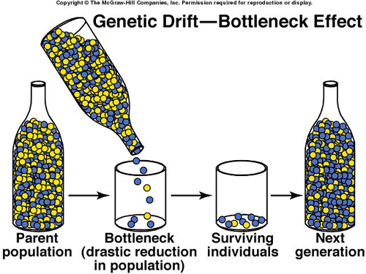
Founder (bottleneck) effect

Slide 10
Migration
Gene flow occurs between two populations if an immigrant brings alleles that are not already present in a population.
This gene flow increases the genetic variation present in the population.

Slide 11
Barriers to gene flow
When two populations become isolated (no interbreeding occurs) the allele frequencies for the two populations will slowly change over time – depending on different selection pressures or other mechanisms mentioned here.
Geographical barriers: oceans, mountains, large lake systems, deserts, ice sheets
Socio-cultural barriers: religion, language, education and economic status

Slide 12
Genetic diseases
An allele that causes an inherited and fatal disease would gradually be eliminated from a population. This is not always the case:
Tay-Sachs: heterozygous increases resistance to tuberculosis
Sickle-cell anaemia: heterozygous provides a degree of immunity against malaria.

Slide 13
Tay-Sachs disease
Missing enzyme causes the accumulation of a fatty substance in the nervous system resulting in death by age of 4 – 5 years.
Jews from Eastern Europe have a much higher frequency of carriers in the gene pool (Jewish populations have tended to be small and isolated – genetic drift)
Heterozygotes have a selection advantage where tuberculosis is prevalent
Due to discrimination Jews in Eastern Europe often found themselves in overcrowded ghetto that would increase the threat of tuberculosis.

Slide 14
Sickle-cell anaemia
Red blood cells – misshaped and cannot carry oxygen effectively, clump and block smaller blood vessels
Heterozygotes show mild “sickling” – a selection disadvantage (but a greater selection advantage regarding malaria immunity
Tropical zone of Africa – 40% of the population are carriers for the sickle cell allele
The allele is maintained only in the environment where malaria is prevalent.

Slide 15
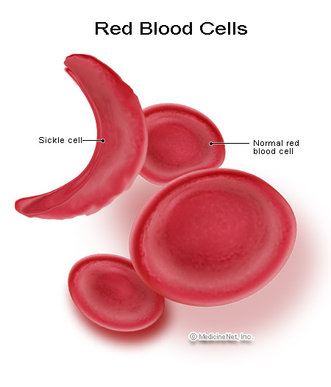
Sickle-cell anaemia

Slide 16
Evolution through natural selection
Charles Darwin published, “On the Origin of Species” in 1859
Between 1831 and 1836 he had travelled around the world on the HMAS Beagle making observation and collecting evidence which he included in his book.
His ideas have been adapted based on increasing scientific knowledge (especially regarding molecular genetics) however the principal remains the same

Slide 17
Evolution through natural selection
There is variation of characteristics within a species
More offspring of a species are produced that can possibly survive to maturity.
Due to limited resources and the excessive birth rate, there is competition between individuals and thus a struggle for existence

Slide 18
Evolution through natural selection
The individuals with characteristics best suited to the environment have more chance of surviving and reproducing (survival of the fittest)
These characteristics that enhance survival are passed on to the next generation in a higher proportion than was present.
The proportion of alleles that produce these characteristics gradually increases.

Slide 19
Body shape
Humans populations who live in cold areas have long bodies and short limbs – reducing their surface area meaning they loose less heat in cold environments giving them a selection advantage.
Conversely, humans populations who have developed in warm areas have short bodies long limbs to increase their surface area off which they can loose heat.

Slide 20
Sickle-cell anaemia and malaria
Selection pressure against sickling – reduces oxygen transport around the body.
Selection pressure for heterozygous form of sickling – provides a degree of immunity against malaria.
Sickling is still widespread in its in areas where malaria is also common.

Slide 21
Speciation
Species: a group of individuals who share many characteristics and are able to breed in the wild (under natural conditions)
If two populations of the same species where isolated and subjected to different selection pressures. Over time they would become so different they would be unable to interbreed and therefore would become two distinct species – with gene pools incapable of interacting

Slide 22
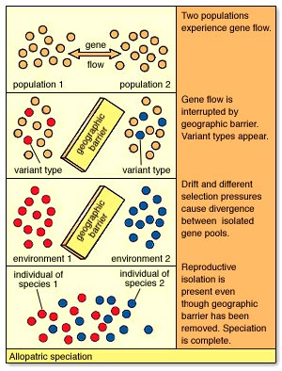
Speciation

Slide 23
http://www.edparadigm.com/sessions/science/selectionSim.html

